Slide 1
Systems Analysis and Design CT026-3-1 Version 1
Introduction and Overview

Slide 2
Lecturer information
Lecturer Name: Fatemeh Meskaran
Email: Fatemeh.meskaran@staffemail.apu.edu.my
Telephone Extension:

Slide 3
Pre-requisites for this module
No pre-requisites

Slide 4
Aims of this module
This module is to provide knowledge of basic techniques of system analysis and design. Furthermore the module will also require the student to apply the knowledge to the analysis and design of a given case study, and present the design to stakeholders.

Slide 5
Course Learning outcomes, CLOs
At the end of this course, YOU should be able to:
Describe the fundamentals of analysis and design in systems development.
2. Apply to appropriate standard, the key techniques of analysis and design for a given case study.
3. Describe how the techniques and framework of activities, including key user interface issues, are used together to develop a system

Slide 6
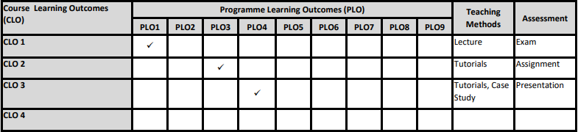
Mapping of CLOs with MOEs Domain
PLO1 – Knowledge
PLO3 – Problem Solving and Scientific Skills
PLO4 – Communication Skills

Slide 7
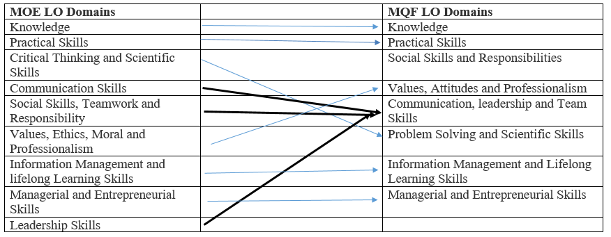
MQF and MOE Domains

Slide 8
Teaching Strategies
Lecture
Tutorial
Case Study

Slide 9
Assessment Methods
Final Exam (50%) : CLO1
Continuous Assessment (50%):
Group Assignment (40%) : CLO2
-Analysis and design for a given case study
Presentation (10%) : CLO3
**refer to SAIS for details

Slide 10
Student Learning Time (SLT)
Course Credit Value: 3
Total Learning Hours:
Lecture: 28 hours per semester
Tutorial / Case Study : 14 hours per semester
Independent Learning Time: 58 hours

Slide 11
Methods of Delivery
Hence,
We are now moving from the traditional topic based teaching to outcome-based education

Slide 12
Outcomes Based Education (OBE)
OBE is education based on producing particular educational outcomes that:
Focus on what students can actually do after they are taught
Expect all learners / students to successfully achieve particular (sometimes minimum) level of knowledge and abilities.

Slide 13
So…What is OBE?
It’s
NOT
What we want to teach,
It’s
What You should learn

Slide 14
Course Content Outline
CLO1 : Final Exam (40%)
Lecture
Introduction to Information System
System Analyst and Project Manager
Systems Development Life Cycle (SDLC)
Planning
Analysis
Design
Implementation
Deployment and Maintenance

Slide 15
Course Content Outline
CLO2 : Group Assignment (40%)
CLO3: Presentation (10%)
Tutorial / Case Study
Tutorials on Planning and Analysis stages of SDLC
Tutorials on Design Logical design - Creating DFD from Case Studies
Tutorials on Prototyping Generating wireframe and prototype screens for case studies
Presenting logical designs and prototype screens for case studies

Slide 16
What is expected of you
What is expected of you
You should abide to all the rules & regulation of APU
Proper attire
No speaking of dialects
Attendance is compulsory and valid medical certificates or letters from parents /guardians must support any absence from class.
Three lateness will be equal to one absence
All pagers and handphones should be turned off during lectures.

Slide 17
What support is available for you
Consultation hours
Resources
Reference material
Essential Reading
Essential Reading • Satzinger,J.W., Jackson,R.B., Burd,S.D. (2016). Systems Analysis and Design in a Changing World. 7th ed. Cengage Learning. ISBN: 1305117204 • Valacich,J.A., George,J. (2016). Modern Systems Analysis and Design. 8th ed. Pearson. ISBN: 0134204921
Suggested Reading
• Schwalbe,K. (2016). Information technology project management. 8th ed. Course Technology. ISBN: 9781285452340
Internet resources

Slide 18
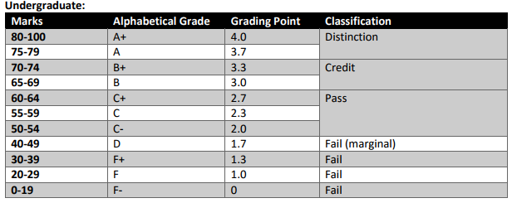
Achievement requirements

Slide 19
Question and Answer Session
Q & A

Slide 20
Next Session
Introduction to Information System

